Slide 1
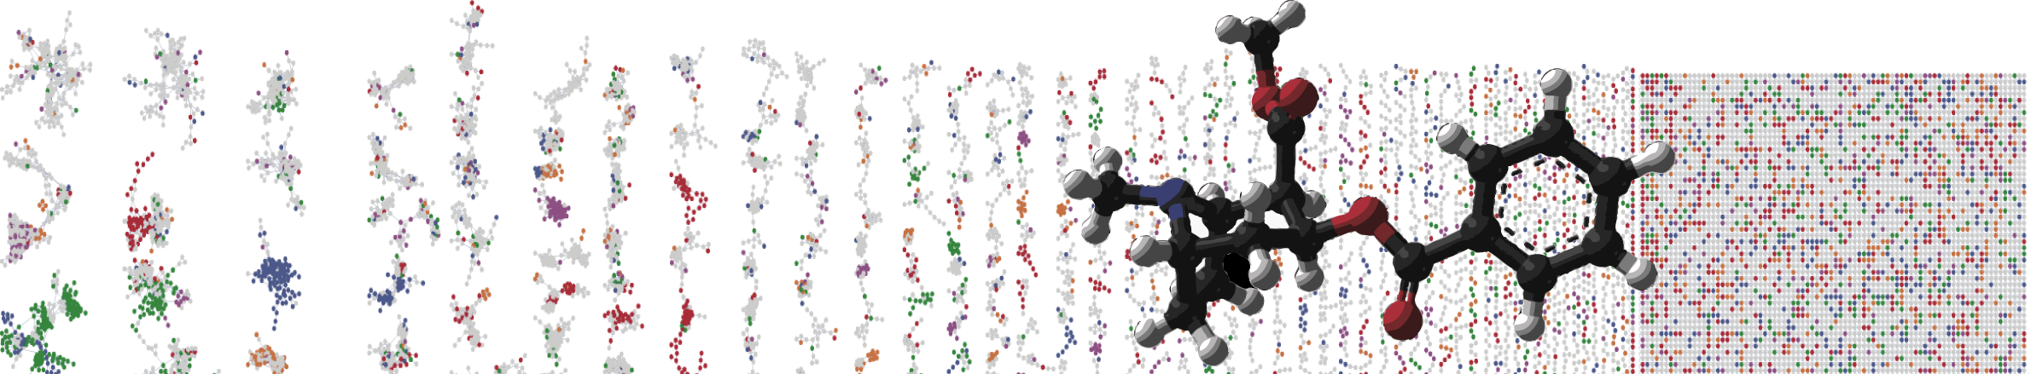


Natural Product Dereplication and molecular networking with the Global Natural Products Social Networking (GNPS) platform
ENTER AUTHORS HERE
University of California - San Diego

Slide 2
Objectives and Data
Utilize GNPS online interface
Explore library identifications
Explore molecular network
Discover new antibiotic analogs exercise
Link to the GNPS job: https://gnps.ucsd.edu/ProteoSAFe/status.jsp?task=1ad7bc366aef45ce81d2dfcca0a9a5e7
Interactive Link

Slide 3
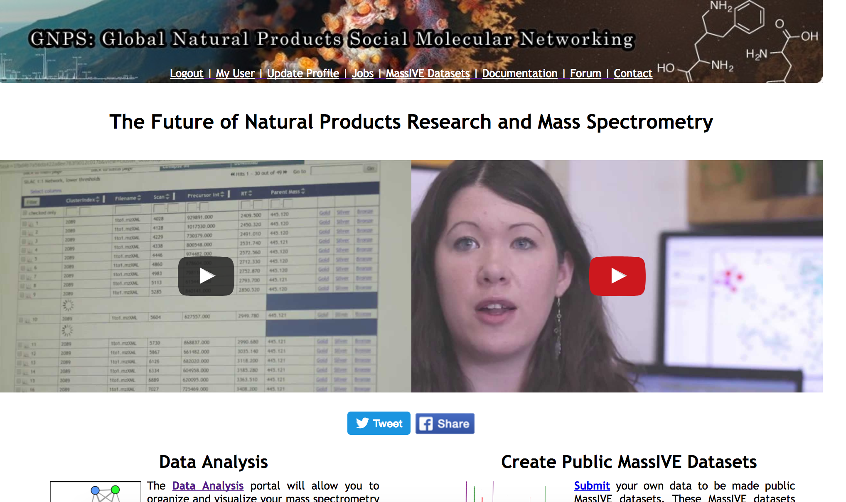
Lets analyze your molecular network.

Slide 4
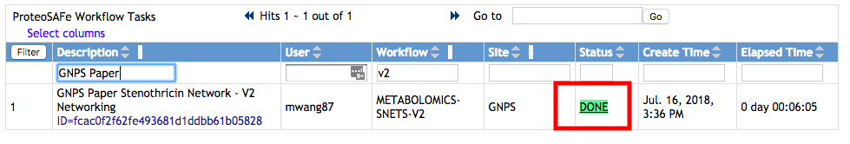
Select Done Job
Interactive Link

Slide 5
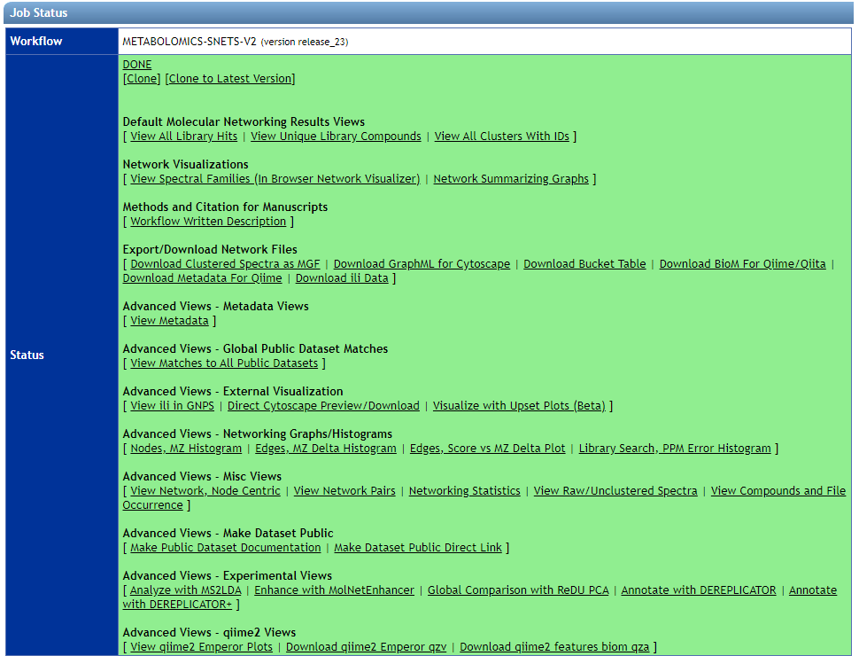
Explore Known Compounds
Interactive Link

Slide 6
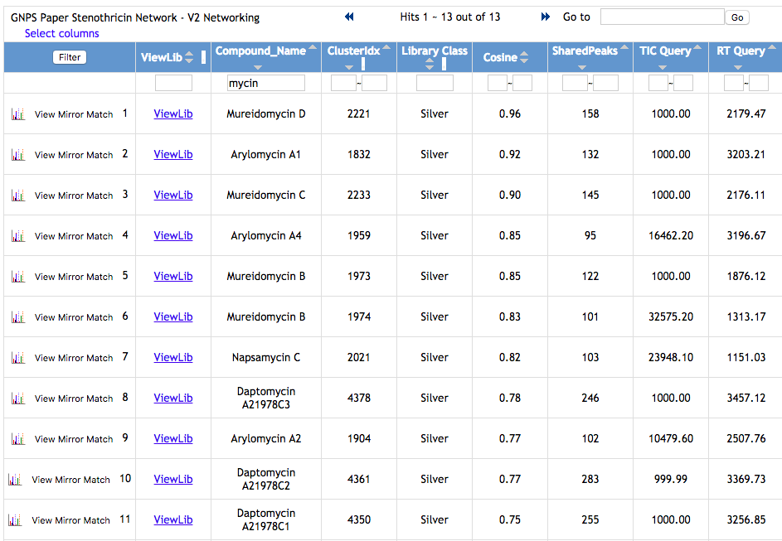
Find Stenothricin, Arylomycin, Mureidomycin, Daptomycin
Interactive Link

Slide 7
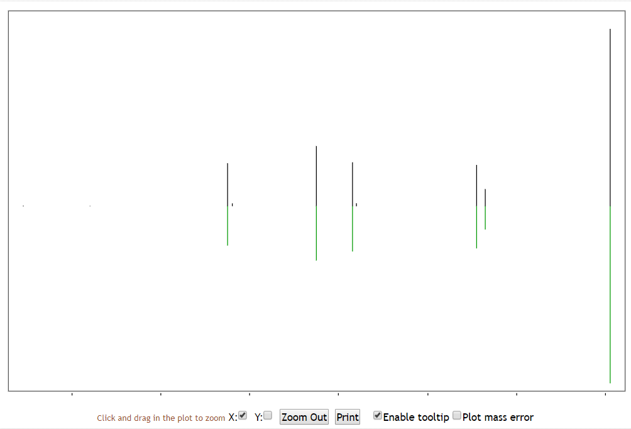
Visualize MS/MS Match

Slide 8
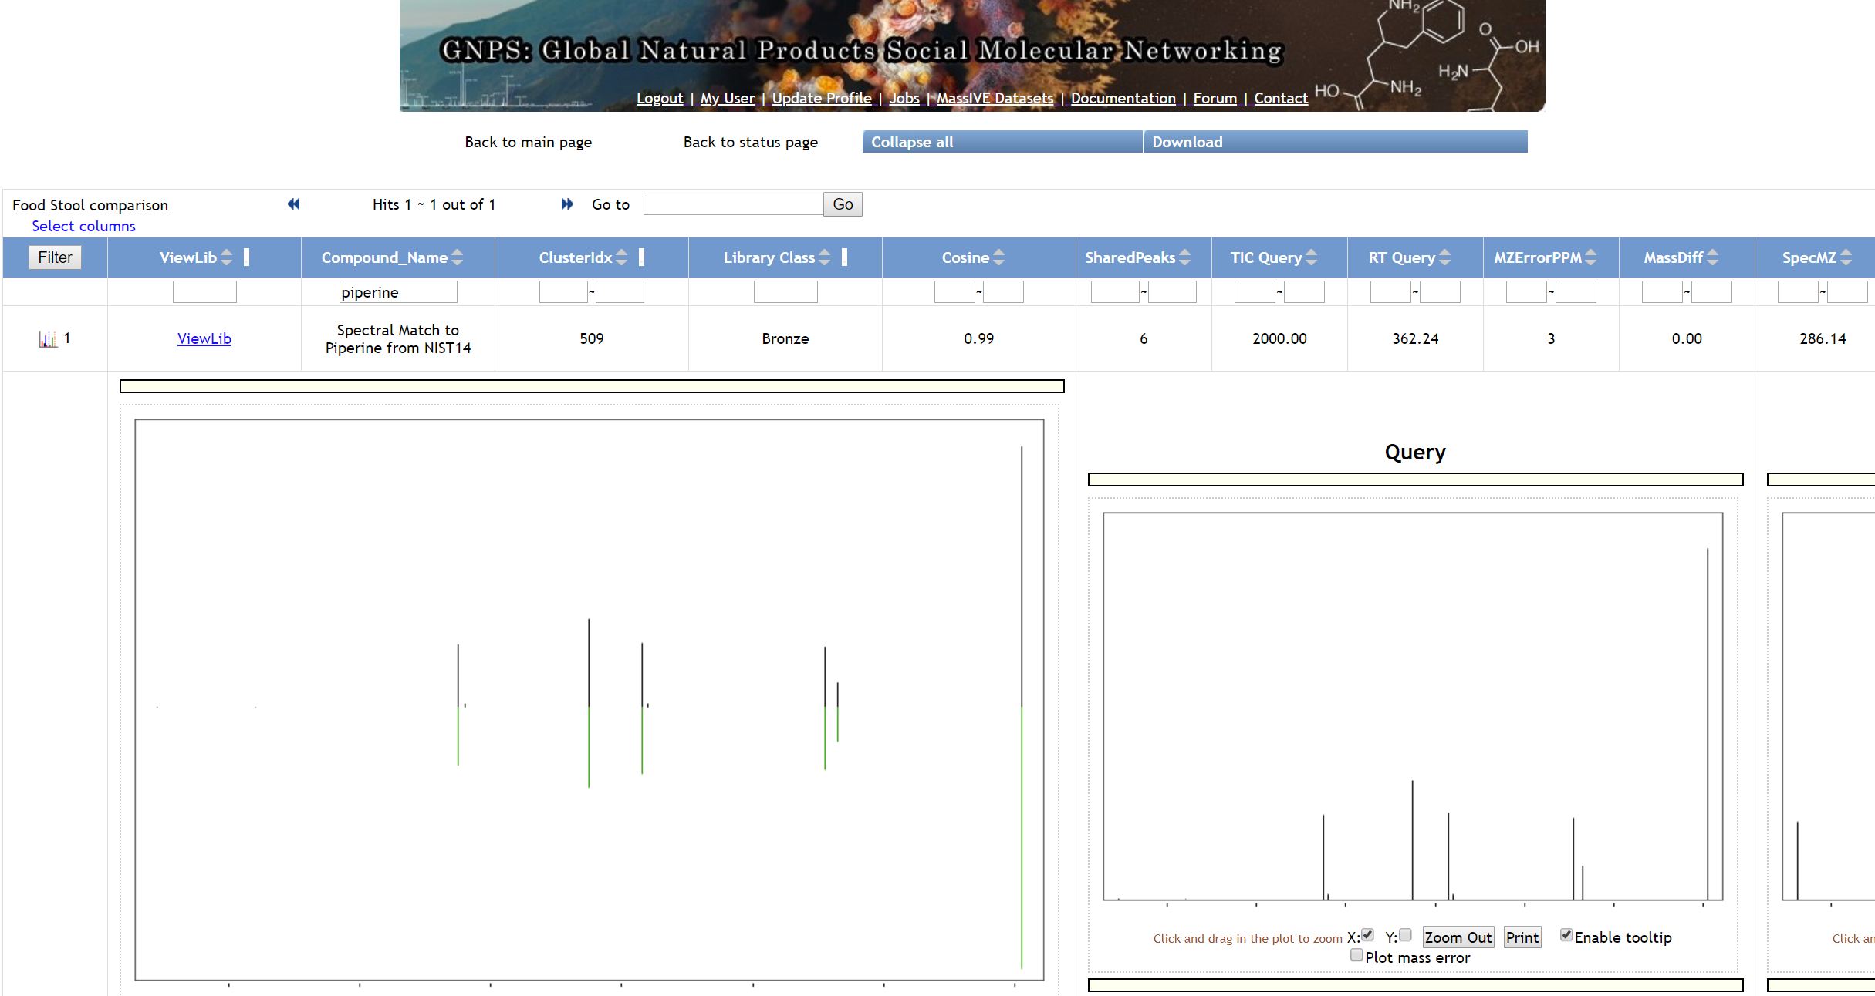
Interactive Link

Slide 9
Explore Molecular Networks
Interactive Link

Slide 10
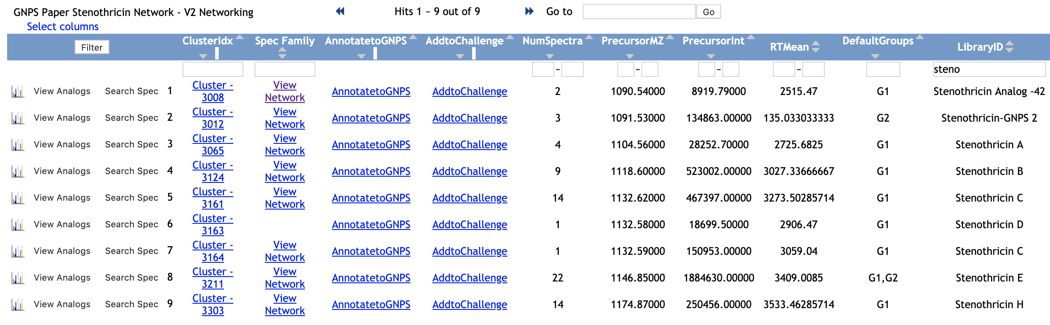
Explore Network of Stenothricin
Search for “steno”
in the “LibraryID” column
Interactive Link

Slide 11
Explore Network of Stenothricin
Strept. roseosporus in Red
Strept. DSM4950 in Blue
Interactive Link

Slide 12
Explore Network of Stenothricin
Highlighting key fragments
in Stenothricins
m/z 894 for the core
1. Load
3. Display
Interactive Link
2. Fill

Slide 13
Workshop Tasks:
Find putative analog of Arylomycin
Find putative analog of Mureidomycin D
Which organism were these compounds found in?
The “Stenothricin GNPS” (right)
produces a core ion (m/z 853):
detect novel derivatives
with molecular networking
m/z 853
for the core

Slide 14
Questions, Problems or Bugs?
Documentation: https://ccms-ucsd.github.io/GNPSDocumentation/
Forum: https://groups.google.com/forum/#!forum/molecular_networking_bug_reports
PRESENTER NAMES AND EMAILS HERE

